Slide 1
UNIT-2
EXCEPTION HANDLING AND MULTI THREADING:
Exception Handling: Concepts of exception handling, Types of exceptions, Usage of try,
catch, throw, throws and finally keywords, Built-in exceptions, User defined exception.

Slide 2
Errors in a java program
There are basically three types of errors in a java program.
1.Compile-Time errors:
These are Syntactical errors found in the code , due to which a program fails
To compile.eg: Forgetting a semicolon at the end of a java statement, or writing a
Statement without proper syntax will result in compile-time error.
ExProgram:
class Err
{
public static void main(String args[])
{
System.out.println(“Welcome to Exceptions”)
}
}
The above program , we are not writing a semicolon at the end of the statement. This is will be detected by the java compiler. Detecting and correcting compile-time errors is easy as the java compiler displays the list of errors with in the line numbers along with their descriptions.

Slide 3
Run-time errors:
These errors represent inefficiency of the computer system to
execute a Particular statement. Eg. Insufficient memory to store something or inability
of the microprocessor to execute some statement come under “Run-time errors”.
class Err
{
public static void main()
{
System.out.println(“Welcome to Exceptions”)
}
}
Runtime errors are not detected by the java compiler. They are detected by the JVM, only
At runtime

Slide 4
Logical errors:
These errors depict flows in the logic of the program .The
Programmer might be using a wrong formula or the design of the program Itself is wrong. Logical errors are not detected either by java compiler or Jvm. The programmer is responsible for them.
Write a java program to find out Addition of two numbers
class Err
{
public static void main(String args[])
{
int a=10,b=20;
c=a-b;
System.out.println(“Addtion”+c)
}
}

Slide 5
Exceptions:
Basically, An exception is a runtime error. All Exceptions occur only at runtime but some exceptions are detected at compile time and some others at runtime. The exceptions that are checked at compilation time by the java compiler are called “Checked Exceptions” while the exceptions that Are checked by the jvm are called “Unchecked Exceptions”

Slide 6
Exception Handling in Java
Handle the runtime errors.
Dictionary Meaning: Exception is an abnormal condition.
Ex: ClassNotFoundException, IOException, SQLException, RemoteException, etc.
Advantage of Exception Handling
To maintain the normal flow of the application.
EX:
statement 1;
statement 2;
statement 3;//exception occurs
statement 4;
statement 5;
statement 6;

Slide 7
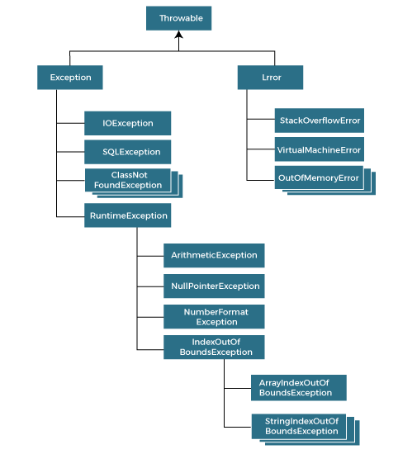
Hierarchy of Java Exception classes

Slide 8
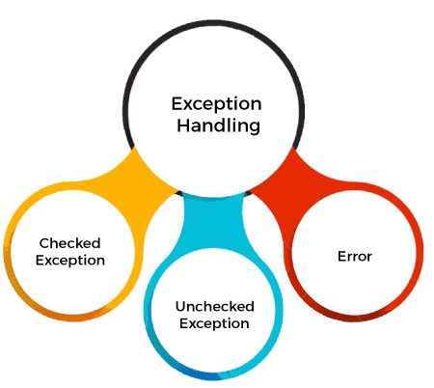
Types of Java Exceptions

Slide 9
1) Checked Exception
The classes that directly inherit the Throwable class except RuntimeException and Error are known as checked exceptions. Example: IOException, SQLException, etc. Checked exceptions are checked at compile-time.
2) Unchecked Exception
The classes that inherit the RuntimeException are known as unchecked exceptions.
Example:ArithmeticException,NullPointerException, ArrayIndexOutOfBoundsException, etc. Unchecked exceptions are not checked at compile-time, but they are checked at runtime.
3) Error
Error is irrecoverable.
Ex:OutOfMemoryError, VirtualMachineError, AssertionError etc.

Slide 10
Write a program that opens the files in the beginning. Then the number of command line
arguments is accepted Into n. This n divides a number 45 and the result is stored into a .
Finally the files are closed.
// an exception example
class Ex
{
public static void main(String args[])
{
// open the file
System.out.println("Open The file");
int n=args.length;
System.out.println("n="+n);
int a=45/n;
System.out.println("a="+a);
//close the file
System.out.println("Close the file");
}
}

Slide 11
When there is an exception, The user data may be corrupted. This should be tackled by
the programmer By carefully designing the program. For this ,he should perform the
following 3 steps.
Step 1:
The Programmer should observe the statements in his program where there may be a
possibility Of exceptions. Such statements should be written inside a try block. A try block
looks like
Try
{
statements;
}
The greatness of try block is that even if some exception arises inside it, The program will
Not be terminated. When JVM understands that there is an exception, it stores the exception
Details in an exception stack and then jumps into a catch block.

Slide 12
Step 2: The programmer should write the catch block where he should display the exception details to the user. This helps the user to understand that there is some error in the program. The programmer should also display a message regarding what can be done to avoid this error. Catch block looks like
Catch(Exception class ref)
{
statements;
}
The reference ref above is automatically adjusted to the exception stack where the details of the exception are available.

Slide 13
Step 3: Lastly, The programmer should perform clean up operations like closing the files and terminating the threads. The programmer should write this code in
The finally block. Finally block looks like
finally
{
statements;
}
The specialty of finally block is that the statements inside the finally block are
Executed irrespective of whether there is an exception or not. This ensures that
All the opened files are properly close and all the running threads are properly terminated. So, the data in the files will not be corrupted and the user is at the safe-side.
Performing the above three tasks is called “Exception Handling”.

Slide 14
// an exception handling example
class Ex
{
public static void main(String args[])
{
try
{
// open the file
System.out.println("Open The file");
int n=args.length;
System.out.println("n="+n);
int a=45/n;
System.out.println("a="+a);
//close the file
System.out.println("Close the file");
}

Slide 15
catch(ArithmeticException ae)
{
// display the exception details
System.out.println(ae);
// display the message to the user
System.out.println("Please pass data while running this program");
}
finally
{
// close the files
System.out.println("Close the files");
}
}

Slide 16
Handling Multiple Exceptions:
Most of the times there is possibility of more Than one exception present in the program. In this case, the programmer Should write multiple catch blocks to handle each one of them.
// How to handle multiple exceptions
class Ex
{
public static void main(String args[])
{
try
{
// open the file
System.out.println("Open The file");
int n=args.length;
System.out.println("n="+n);
int a=45/n;
System.out.println("a="+a);
int b[]={10,20,30};
b[100]=100;
}

Slide 17
catch(ArithmeticException ae)
{
System.out.println(ae);
// display the message to the user
System.out.println("Please pass data while running this program");
}
catch(ArrayIndexOutOfBoundsException aie)
{
aie.printStackTrace();
System.out.println("Please see that the array index is within the range");
}
finally
{
// close the files
System.out.println("Close the files");
}
}
}

Slide 18
Common Scenarios of Java Exceptions
1) A scenario where ArithmeticException occurs
int a=50/0;//ArithmeticException
2) A scenario where NullPointerException occurs
String s=null;
System.out.println(s.length());//NullPointerException

Slide 19
Common Scenarios of Java Exceptions
3) A scenario where NumberFormatException occurs
String s="abc";
int i=Integer.parseInt(s);//NumberFormatException
4) A scenario where ArrayIndexOutOfBoundsException occurs
int a[]=new int[5];
a[10]=50; //ArrayIndexOutOfBoundsException

Slide 20
Java Exception Keywords
Keyword | Description
try | The "try" keyword is used to specify a block where we should place an exception code. It means we can't use try block alone. The try block must be followed by either catch or finally.
catch | The "catch" block is used to handle the exception. It must be preceded by try block which means we can't use catch block alone. It can be followed by finally block later.
finally | The "finally" block is used to execute the necessary code of the program. It is executed whether an exception is handled or not.
throw | The "throw" keyword is used to throw an exception.
throws | The "throws" keyword is used to declare exceptions. It specifies that there may occur an exception in the method. It doesn't throw an exception. It is always used with method signature.

Slide 21
Throws Clause:
Even if a programmer is not handling runtime exceptions,
the java compiler will Not give any error related to runtime exceptions.
But the rule is that the programmer should handle checked exceptions.
In case the programmer does not want to handle the checked exceptions.
He should Thrown them out using throws clause. Otherwise, There will be
an error flagged by java compiler
Eg:-
/* reading integer value from keyboard*/
import java.io.*;
class Ex
{
int a,b,c;

Slide 22
void input()throws IOException
{
BufferedReader br=new BufferedReader(new InputStreamReader(System.in));
System.out.println("Enter A value");
int a=Integer.parseInt(br.readLine());
System.out.println("Enter B value");
int b=Integer.parseInt(br.readLine());
}
void output()
{
int c=a+b;
System.out.println("The Addition"+c);
}
}

Slide 23
class Demo
{
public static void main(String args[])throws IOException
{
Ex e=new Ex();
e.input();
e.output();
}
}

Slide 24

THROW CLAUSE
There is also a throw statement available in java to throw an exception explicitly and catch it. Let us see how it can be used.
The Java throw keyword is used to throw an exception explicitly.
We specify the exception object which is to be thrown. The Exception has some message with it that provides the error description
Syntax :-
throw new exception_class("error message");
Example:-

Slide 25
class Sample
{
void validate(int age)
{
if(age<18)
{
//throw Arithmetic exception if not eligible to vote
throw new ArithmeticException("Person is not eligible to vote");
}
else
{
System.out.println("Person is eligible to vote!!");
}
}
}

Slide 26
class ThrowDemo
{
public static void main(String args[])
{
Sample s=new Sample();
s.validate(19);
}
}

Slide 27
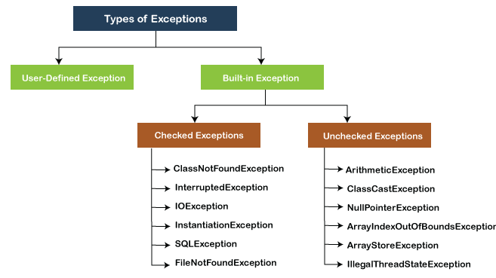
Types of Exception in Java

Slide 28
USER DEFINED EXCEPTIONS:
Sometimes, the built-in exceptions in java are not able to describe a certain
Situation. In such cases, like the built-in exceptions, the user (programmer) can also create his own Exceptions which are called “User-defined exceptions”. The following
Steps are followed in creation of user-defined exceptions.
The user should create an exception class as a subclass to Exception class. Since all
Exceptions are subclasses of Exception class, the user should also make his class a subclass to it. This is done
Eg:- class MyException extends Exception
The user can write a default constructor in his own exception class. He can use it, in
Case he does not want to store any exception details. If the user does not want to create
An empty object to his exception class, he can eliminate writing the default constructor.
MyException()
{
}

Slide 29
The user can create a parameterized constructor with a string as a parameter. He can use
this to store exception Details. He can call super class(Exception) constructor from this
and send the string there.
MyException( String str)
{
super(str); // call exception class constructor and store str there
}
When the user wants to raise his own exception, he should create an object to his
Exception Class and throw it using throw clause.
MyException me=new MyException(“Exception details”);
Throw me;

Slide 30
Ex:-
// user defined exception
// to throw whenever balance amount is below rs.1000
class MyException extends Exception
{
private static int accno []={1001,1002,1003,1004,1005};
private static String name []={"Raju","RamaRao","SubbaRao","AppaRao","LaxmiDevi"};
private static double bal []={10000.00,12000.00,5600.50,999.00,1100.55};
//default constructor
MyException()
{
}
//parameterized constructor
MyException(String str)
{
super(str);
}

Slide 31
public static void main(String args[])
{
try
{
System.out.println("ACCNO"+"\t"+"CUSTOMER"+"\t"+"BALANCE");
for(int i=0;i<5;i++)
{
System.out.println(accno[i]+"\t"+name[i]+"\t"+bal[i]);
if(bal[i]<1000)
{
MyException me=new MyException("Balance amout is less");
throw me;
}
}
}
catch(MyException me)
{
me.printStackTrace();
}
}
}

